Slide 1


SLIIT Students’ Attitudes and Preferences Regarding Extra – curricular Activities at SLIIT

Slide 2
Group Members
IT Numbers | Name
IT23380196 | L.K.P. Yasith
IT23344556 | Jayawickrama W.T. L
IT23189676 | Withana N. K
IT23215306 | R.V.P.P. Nimsara
IT23442498 | Vidanapathirana L. S

Slide 3
Content
Introduction
Overall Analysis
Preference on Sports
Preference on Clubs and Societies
Preferences on Volunteering
Conclusion

Slide 4
Introduction
SLIIT is a leading educational institution in Sri Lanka and offers various programs in the IT field and related regulations. As part of its commitment to excellence, SLIIT not only focuses on academic excellence but also recognizes the importance of providing extra – curricular activities to enhance the overall student's self-discipline and personal integrity. These activities include sports, clubs, volunteering and more.

Slide 5
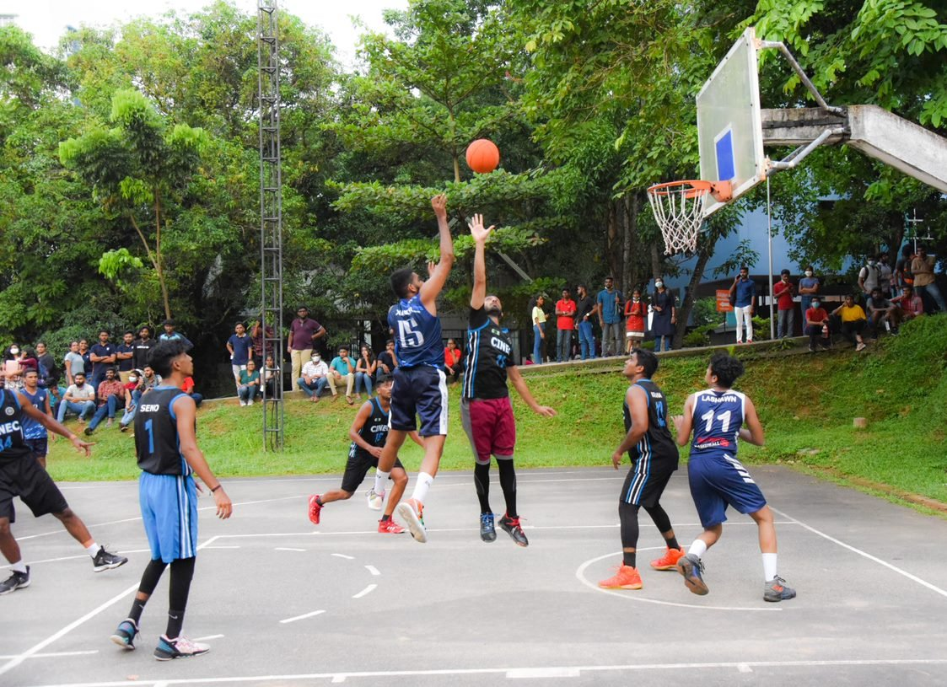
Sports
Participating in sports is an important part of students’ life. SLIIT Sports council promotes sports and recreational activities. At SLIIT, students engage in wide range of sports activities including 19 sports. These include badminton, basketball, swimming, taekwondo, chess, football, rugby and many others.

Slide 6
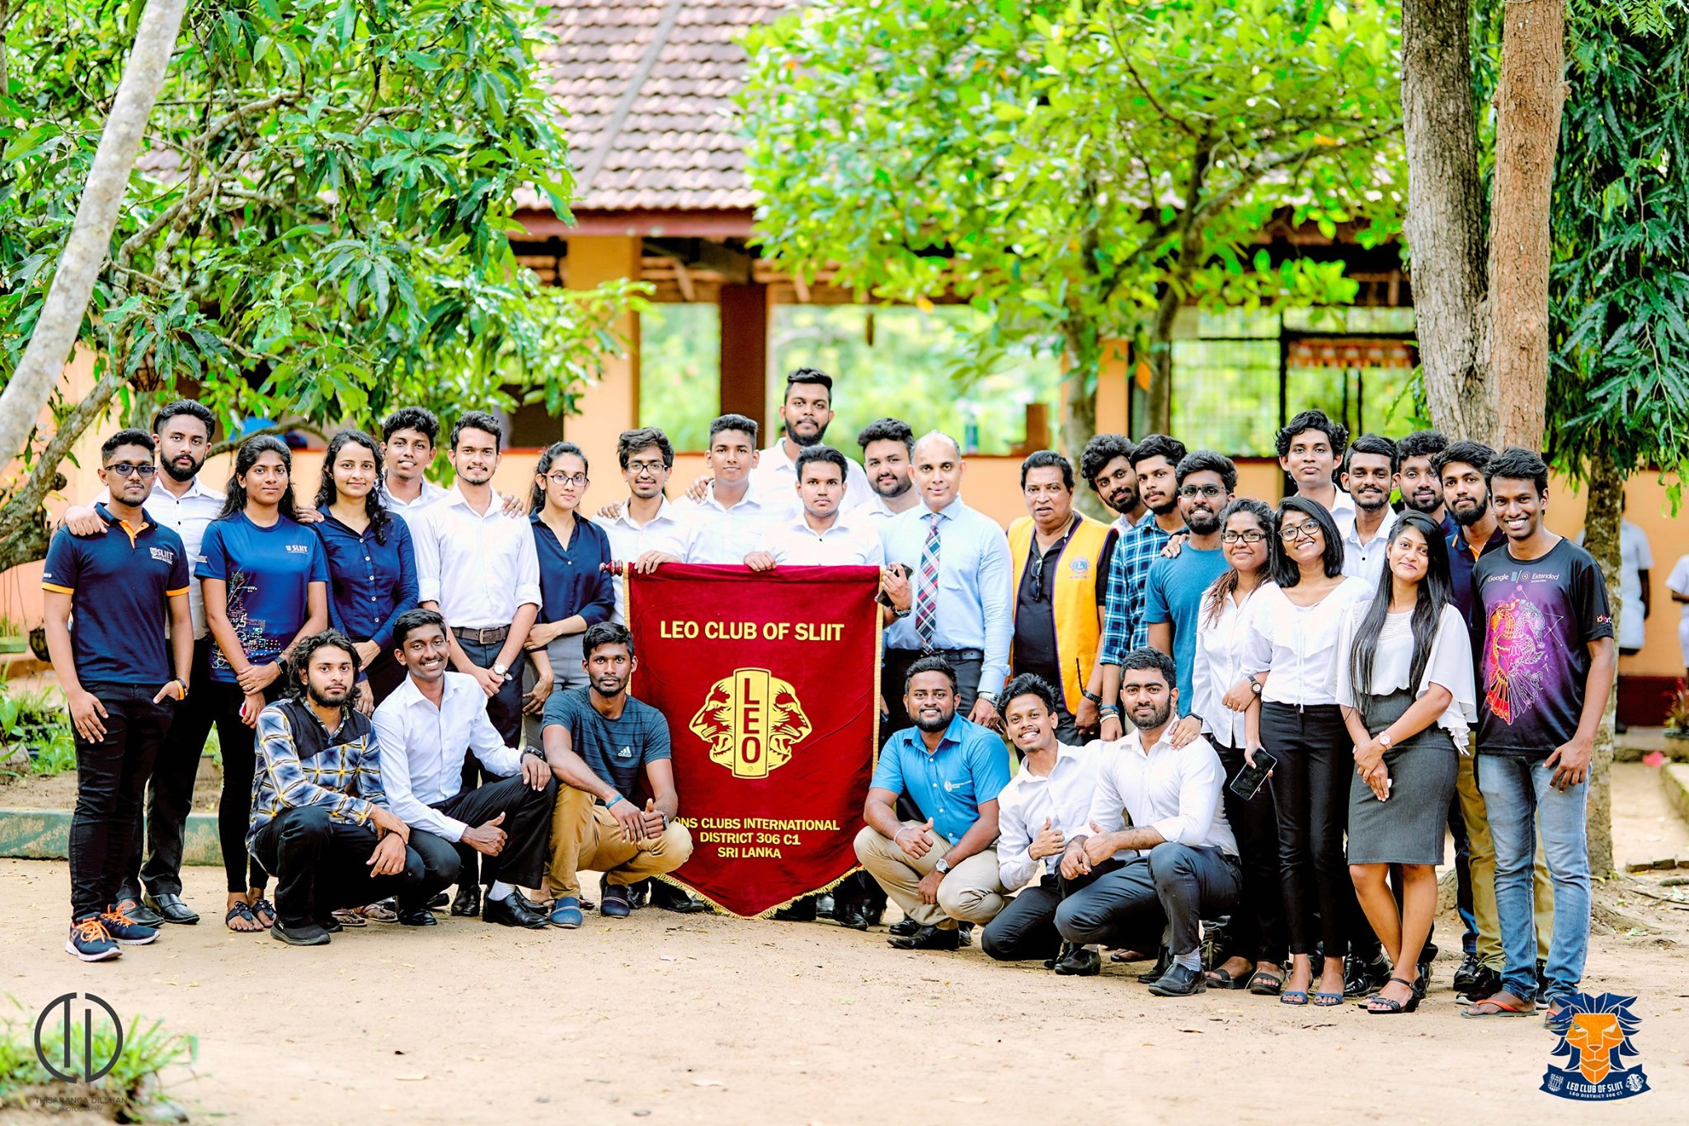
Clubs and Societies
As a leading institution of higher learning in Sri Lanka, SLIIT places great emphasis on the importance of clubs and societies. These organizations form an integral component of the university experience, enriching student life and contributing to a vibrant campus community.

Slide 7
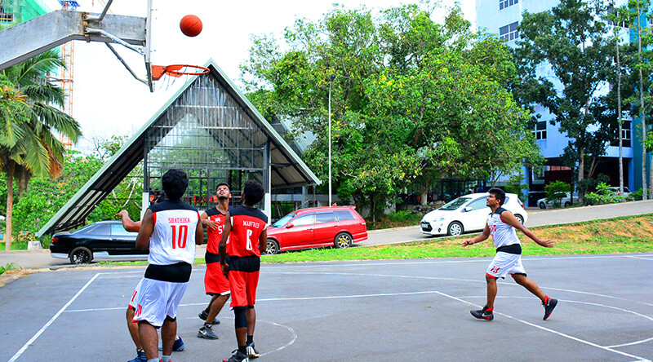
Volunteering
At the dynamic junction of academic and real-world application, SLIIT recently welcomed volunteering initiatives, providing students with valuable opportunities to engage in practical projects and apply their knowledge beyond the classroom.

Slide 8
This presentation serves as an overall analysis of the students' experiences, highlighting their satisfaction levels and identifying areas for improvement in the extra – curricular activities provided by SLIIT.

Slide 9
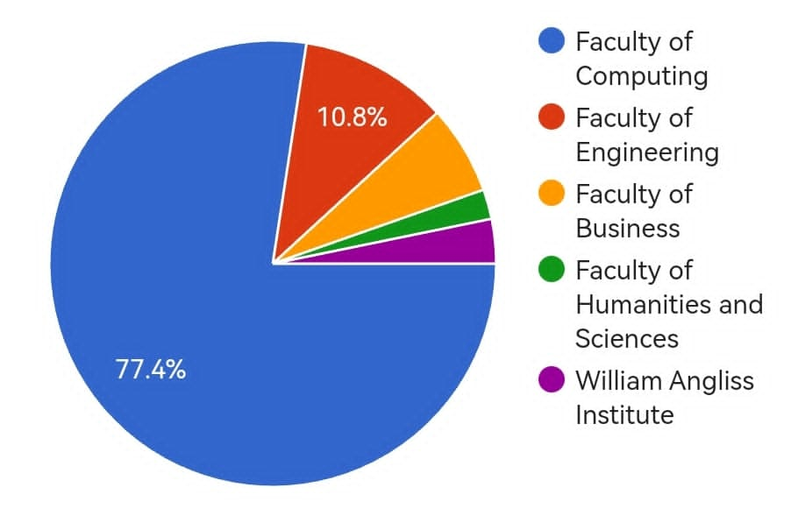
Overall Analysis
Faculty & institute of the 100 Respondents

Slide 10
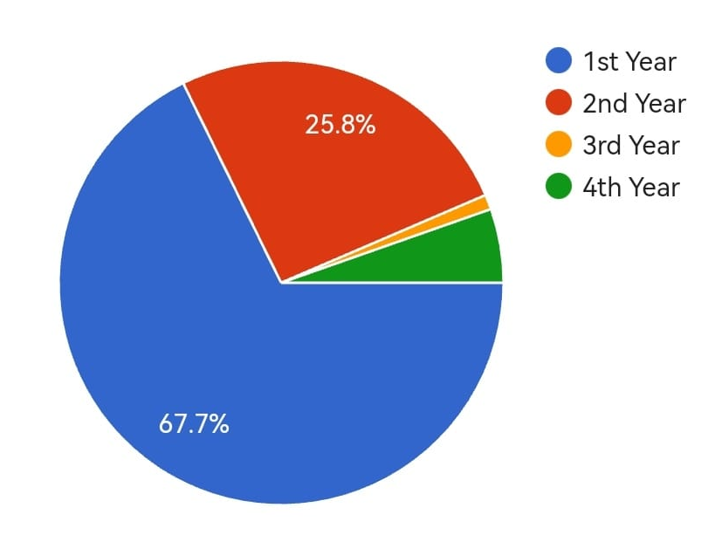
Student Year of the 100 Respondents

Slide 11
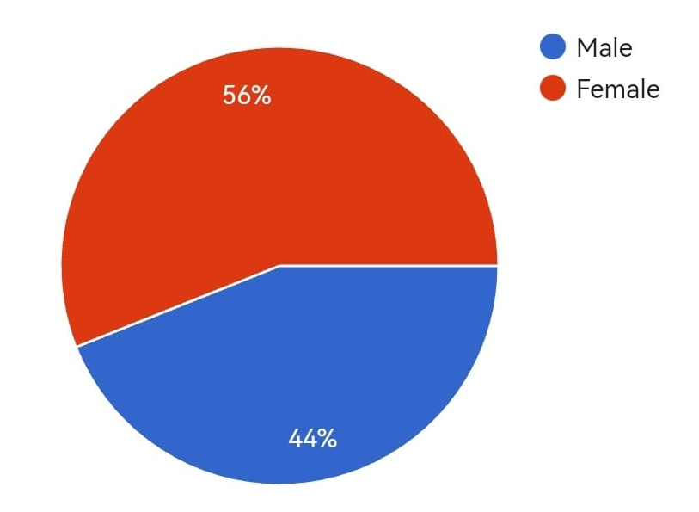
Gender Distribution among 100 Respondents

Slide 12
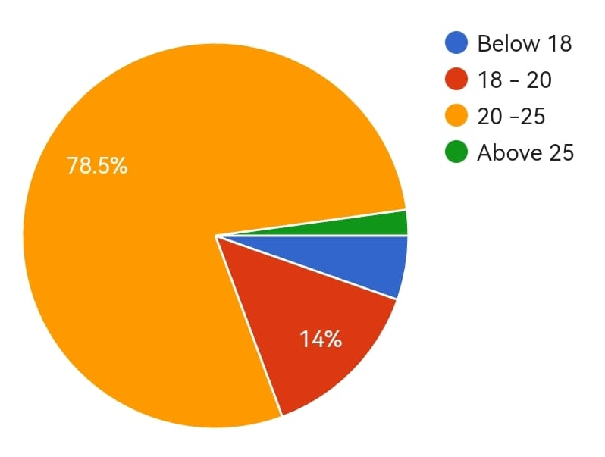
Age Groups of 100 Respondents

Slide 13
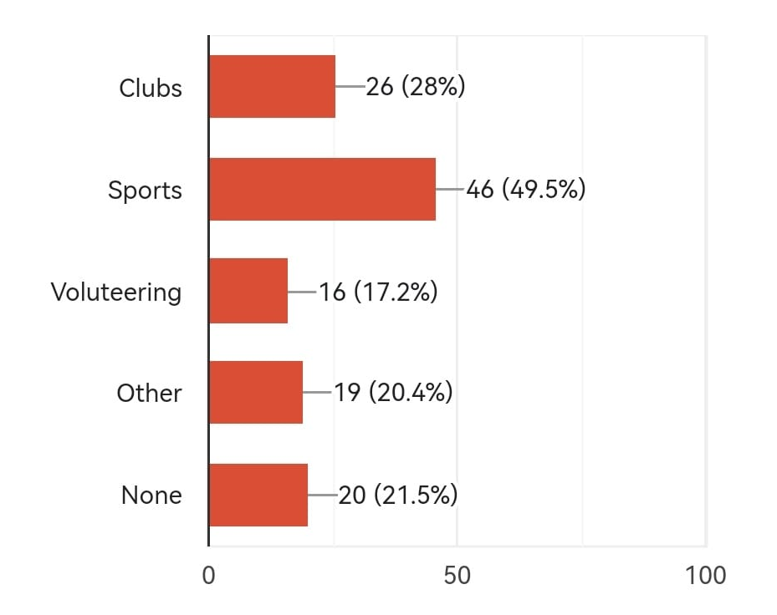
Most Prefer Extra – curricular Activities

Slide 14
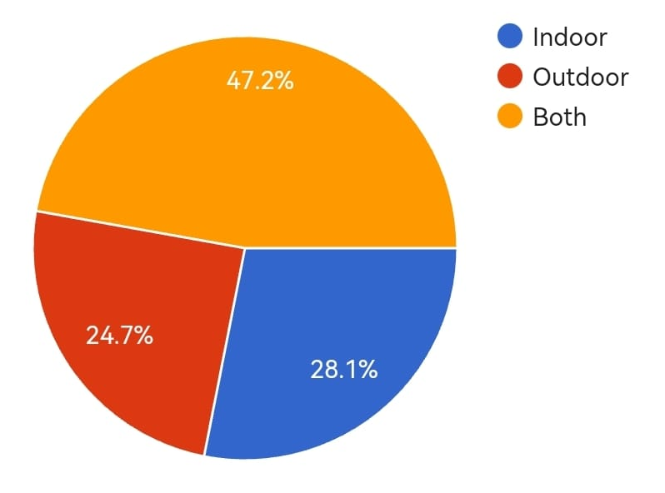
Favorite Type of Extra – curricular Activities

Slide 15
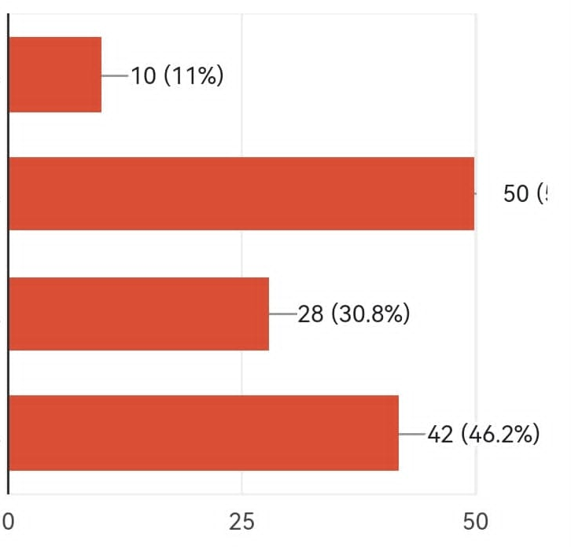
Engaging in Extra – curricular Activities
Weekdays (Afternoon)
Weekdays (Evening)
Weekend (Morning)
Weekend (Evening)

Slide 16
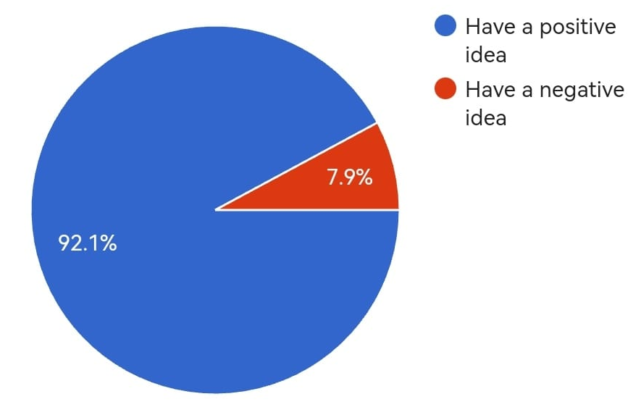
Idea of Extra – curricular Activities by the 100 Respondents

Slide 17
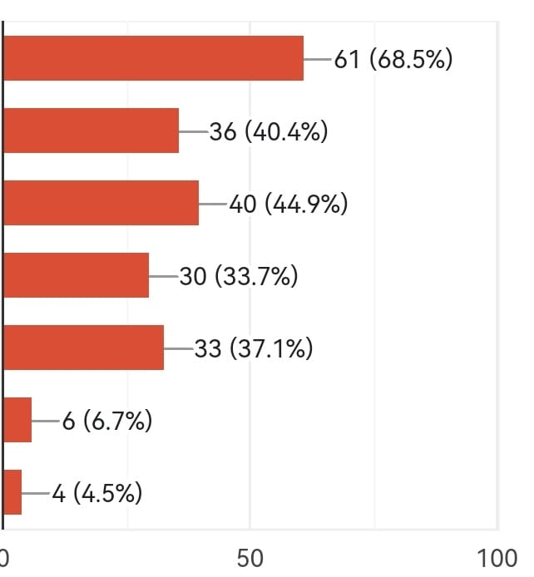
Positive Ideas of Extra – curricular Activities
Mind relaxing
Greater character development
Time management
Greater interest in community involvement
Gain leadership skills
No, I have negative idea
Other

Slide 18
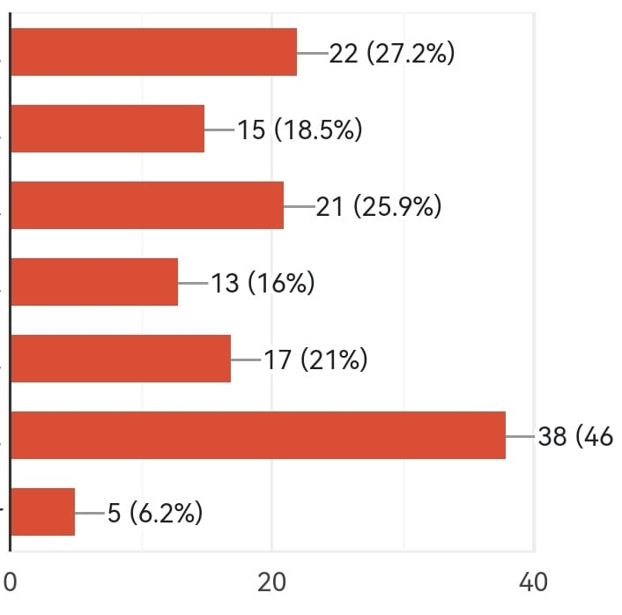
Negative Ideas of Extra – curricular Activities
Too many schedules in short time
Extra expenses in the schedule
Tiredness and frustration
Conscious or unconscious denial of priorities
Time management and commitments
No, I have positive idea
Other

Slide 19
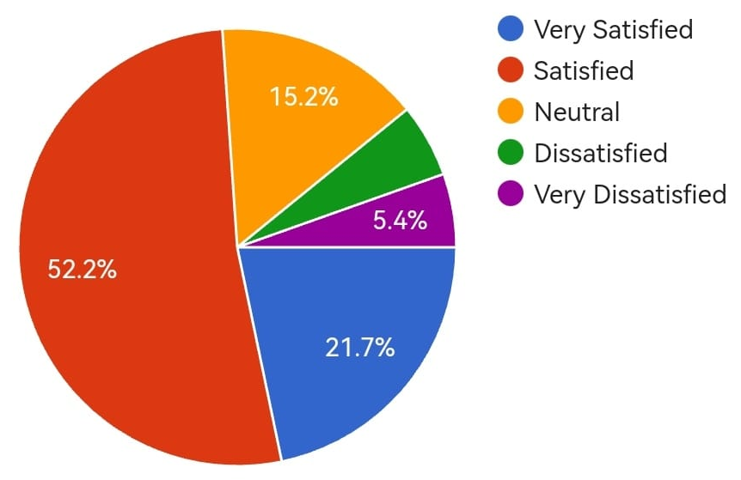
Satisfaction of Extra – curricular Activities

Slide 20
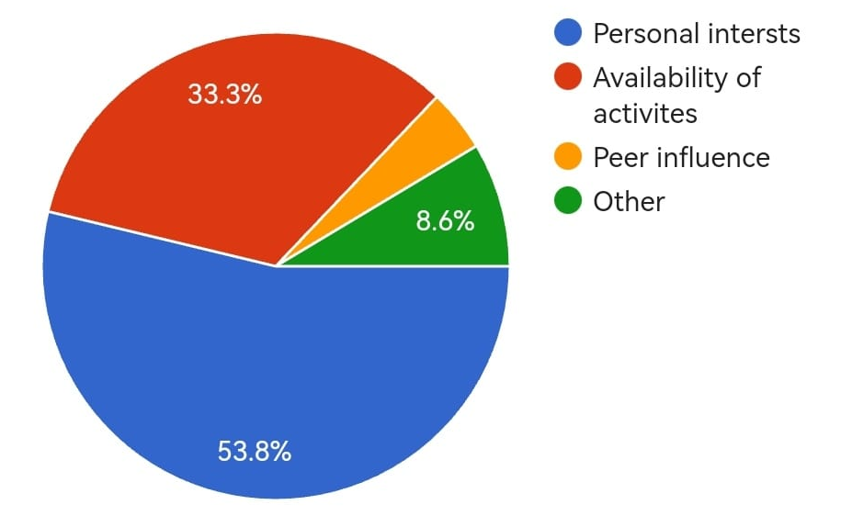
Factors Influence Decision to Participate in Extra – curricular Activities

Slide 21
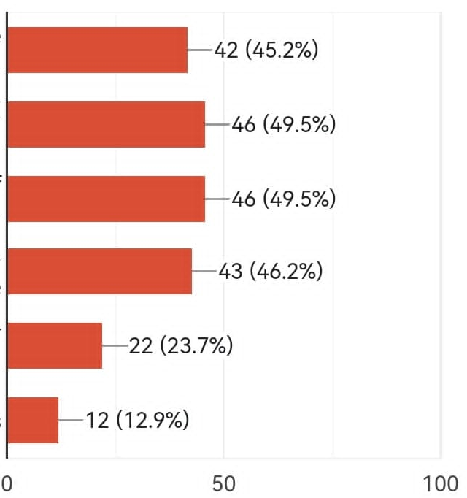
Benefits Perceive from Participating in Extra – curricular Activities
Improved time management skills
Enhanced social and networking opportunities
Development of leadership abilities
Increased self confidence
Better academic performance
Others

Slide 22
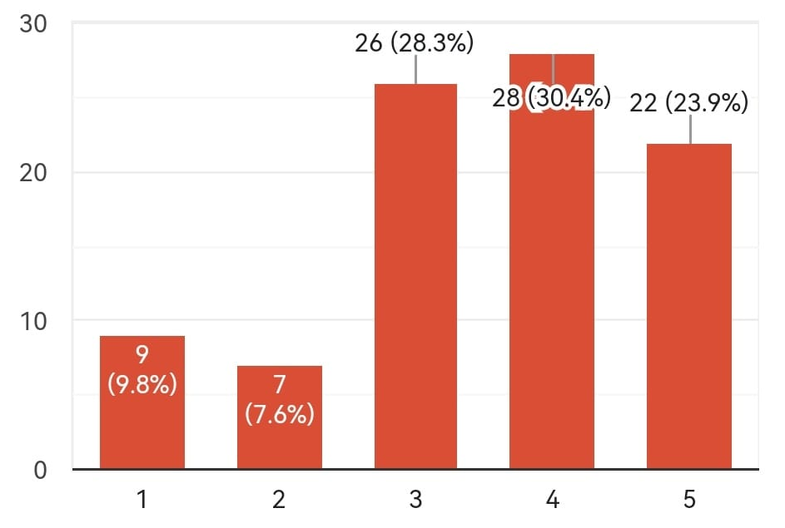
Conclusion
Average Ratings about Extra – curricular Activities by the 100 Respondents

Slide 23
In conclusion SLIIT students generally have a positive attitude regarding the extra – curricular activities. The majority of students have chosen the sports category. It seems that there is a requirement for more extra – curricular activities.

Slide 24
References
https://courseweb.sliit.lk/
https://www.sliit.lk/
https://forms.gle/AC7yTtjFKVmfV79d7

Slide 25
Thank You !

